Slide 1
CEIS101 COURSE PROJECT SMART HOME AUTOMATION AND SECURITY SYSTEM
Presented by:
Pierre M. Liron

Slide 2
INTRODUCTION
Develop a smart home automation and security system by:
The smart home system will encompass various devices to monitor the conditions of the home
Design the prototype in Tinkercad
Build the hardware with the Arduino MEGA 2560 Kit
Program within the Arduino IDE
Door sensor to check whether the door is open or closed
Distance sensor to monitor for a possible home intruder
Automated lights that turn on when it is dark
Water level sensor to monitor for possible flooding
Temperature and humidity sensor to monitor the weather conditions

Slide 3


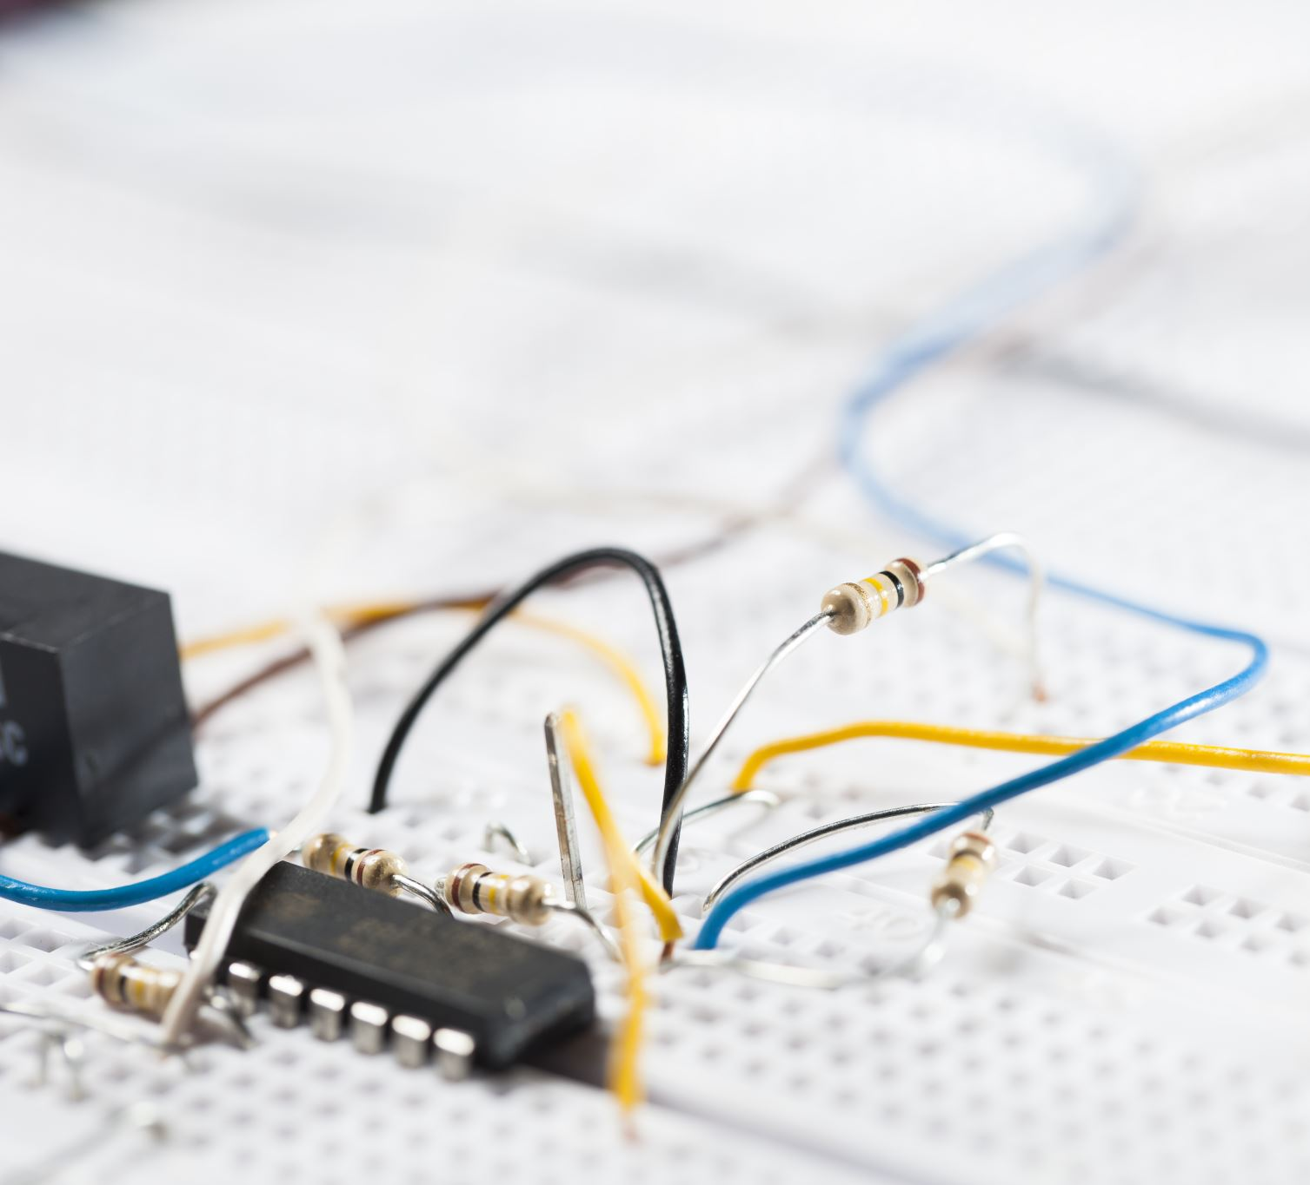
CIRCUIT SIMULATION IN TINKERCAD

Slide 4
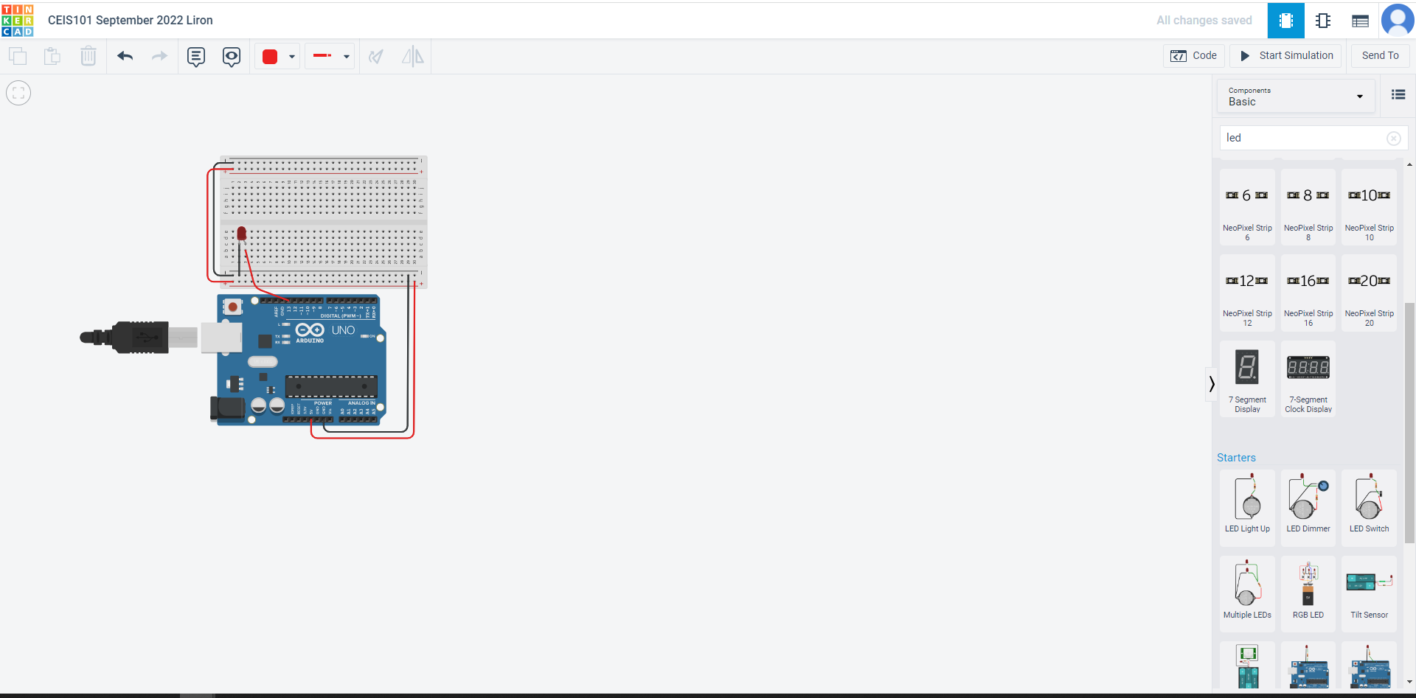
Circuit (screenshot)

Slide 5
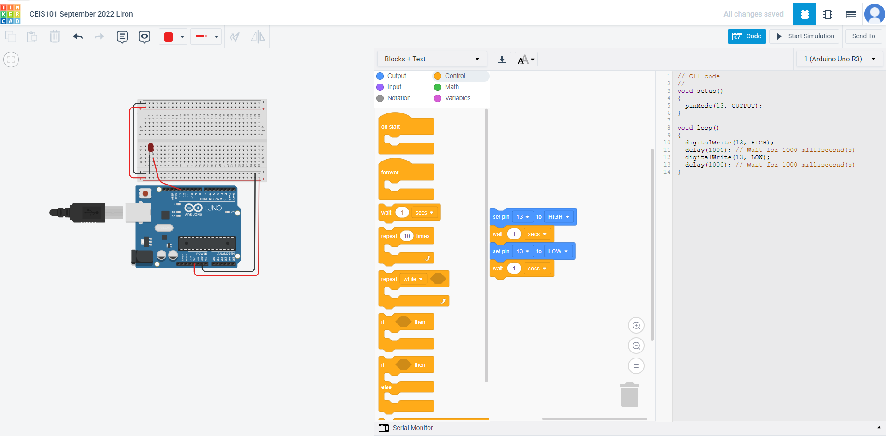
Code (screenshot)

Slide 6

INVENTORY OF PARTS, CIRCUIT BUILDING, DISPLAYING MESSAGES

Slide 7
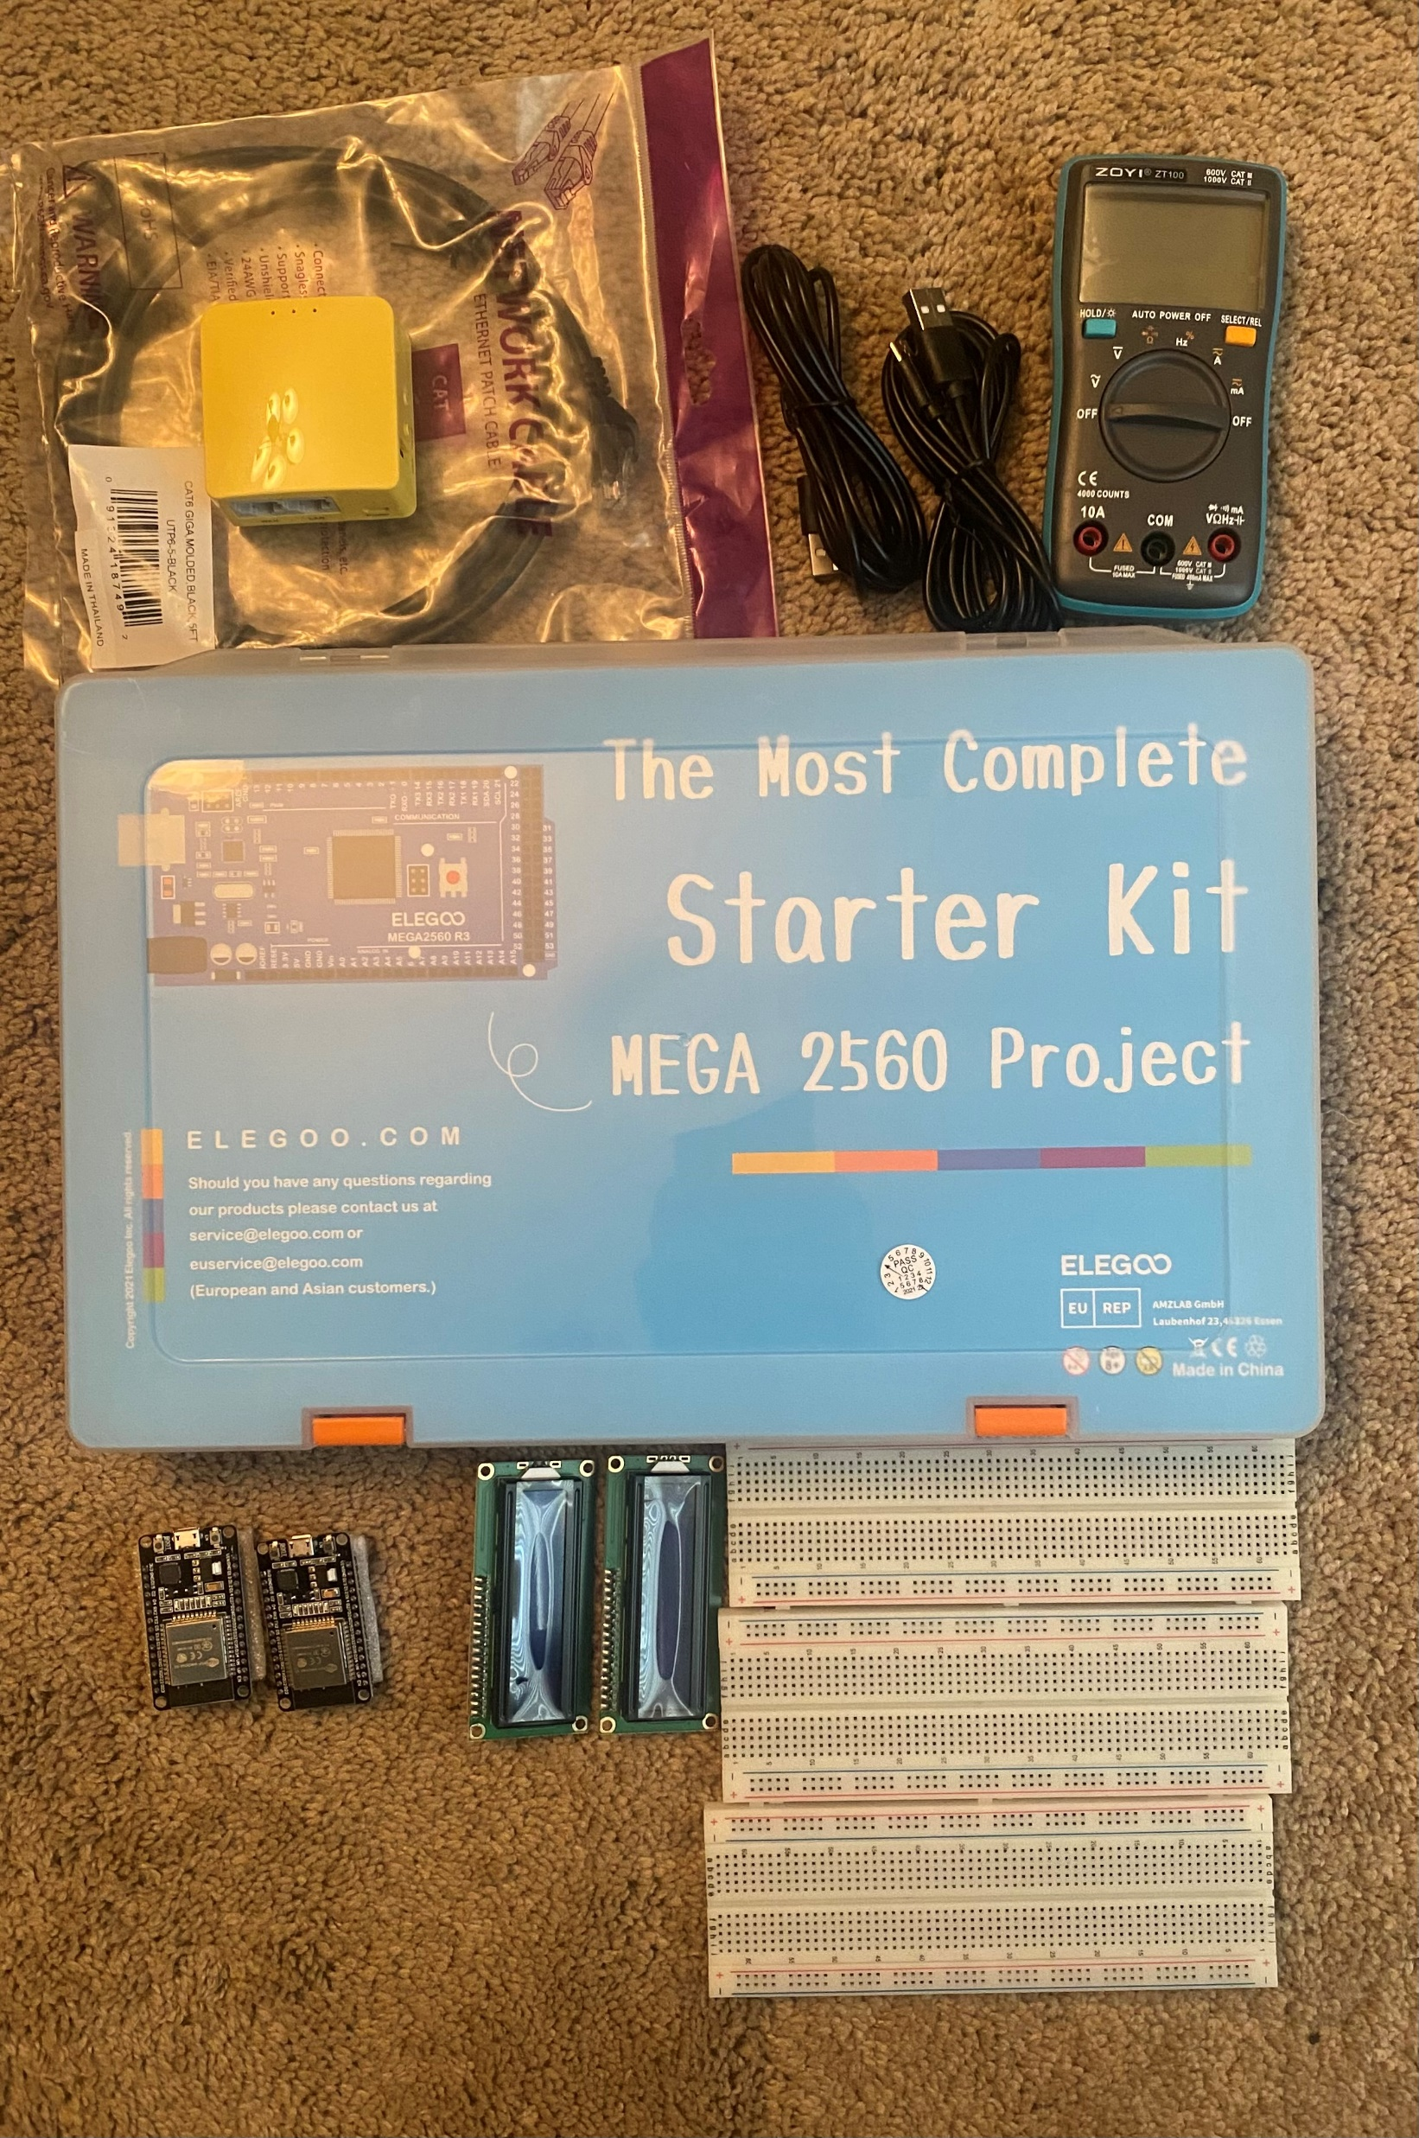
Inventory of IoT Kit (picture)
UCTRONICS Kit
ESP32 (2)
LCD Modules (2)
Breadboards (3)
Mini Router
Patch Cable
Digital Multi Meter
USB to Micro USB (2)

Slide 8
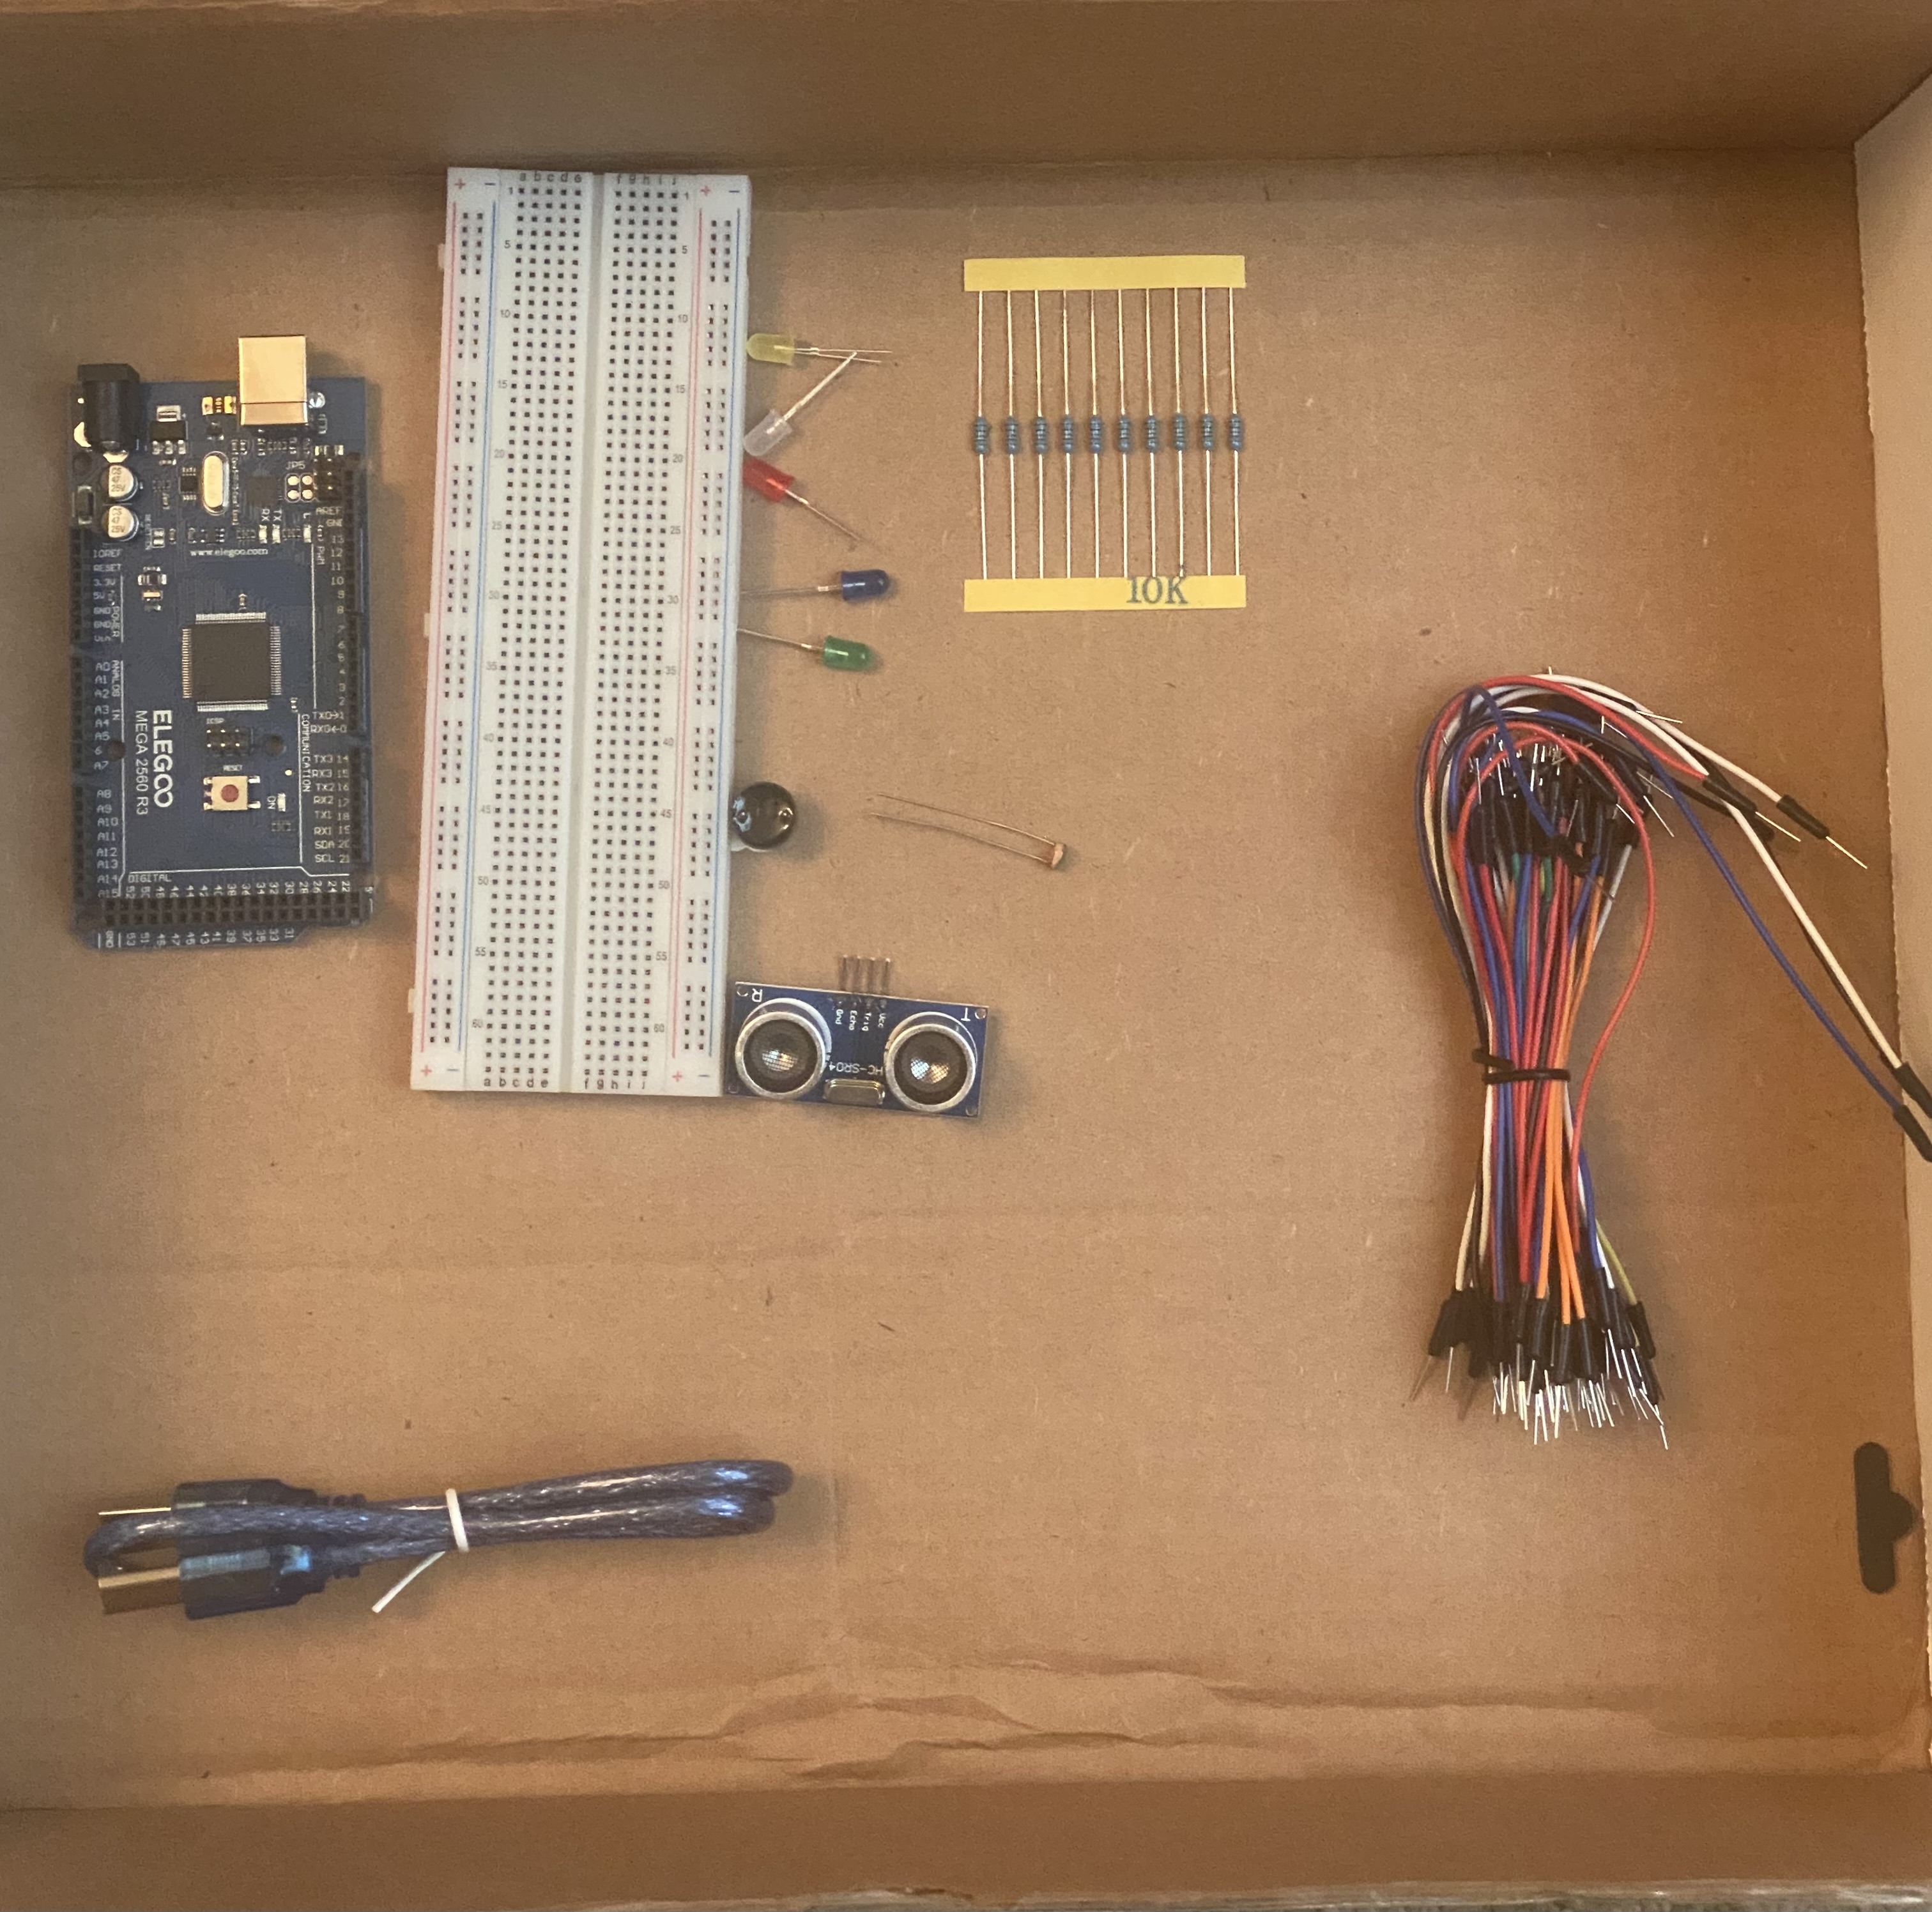
Organization of Project Components (picture)
Arduino Mega 2560
Breadboard
Resistor 10kΩ
LEDs
Ultrasonic Sensor
Active Buzzer
Photoresistor
Wires
USB Type B cable

Slide 9
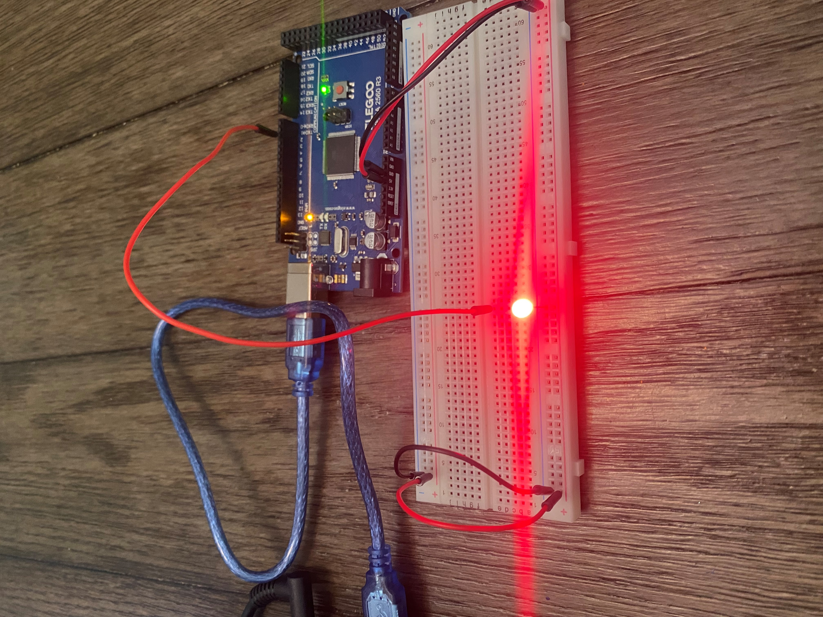
Circuit with red LED on (picture)

Slide 10
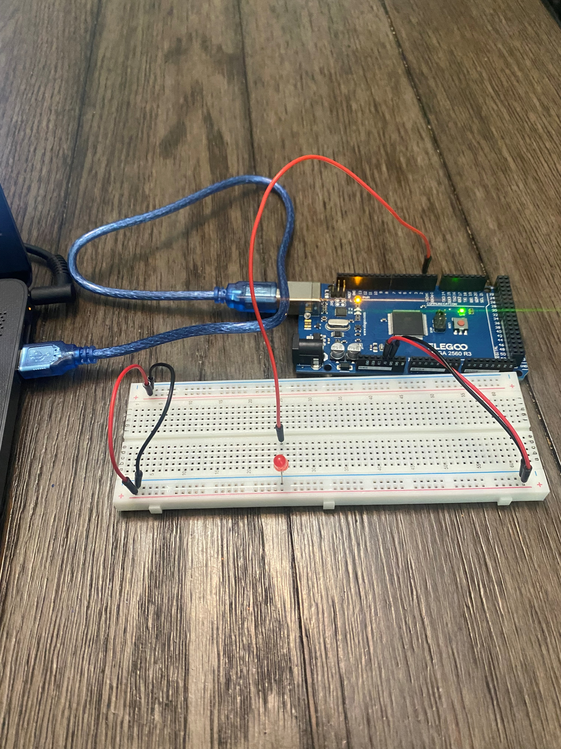
Circuit with red LED off (picture)

Slide 11
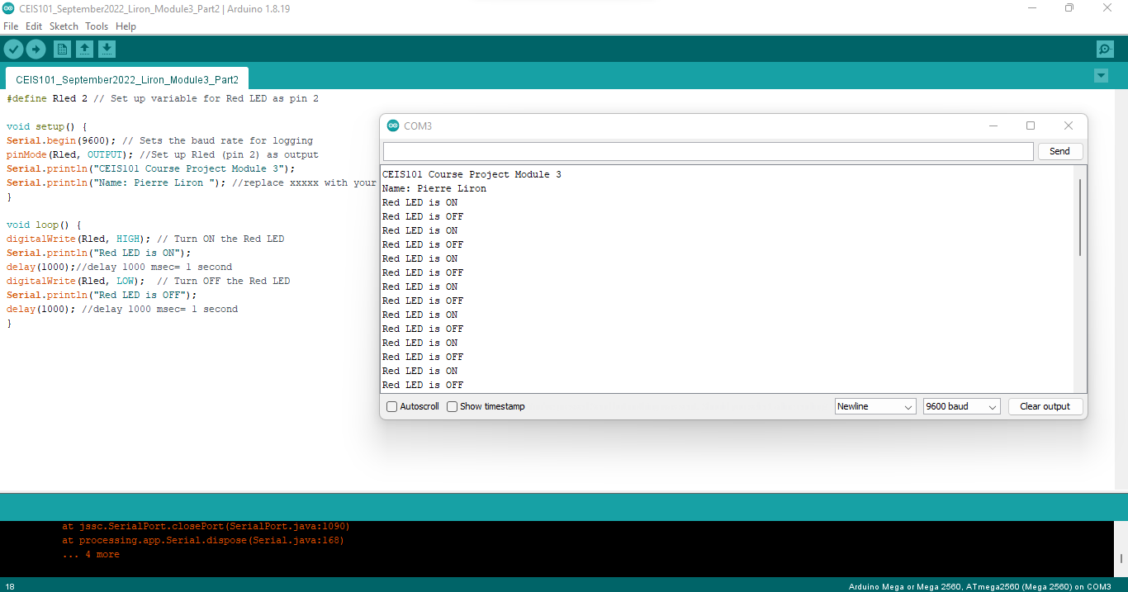
Serial Monitor (screenshot)

Slide 12

ADDING DOOR SENSOR TO SMART HOME SYSTEM

Slide 13
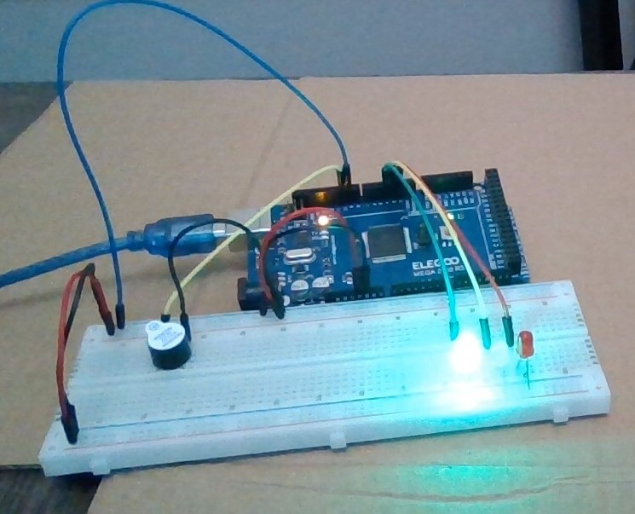
Circuit of door closed with Green LED ON (picture)

Slide 14
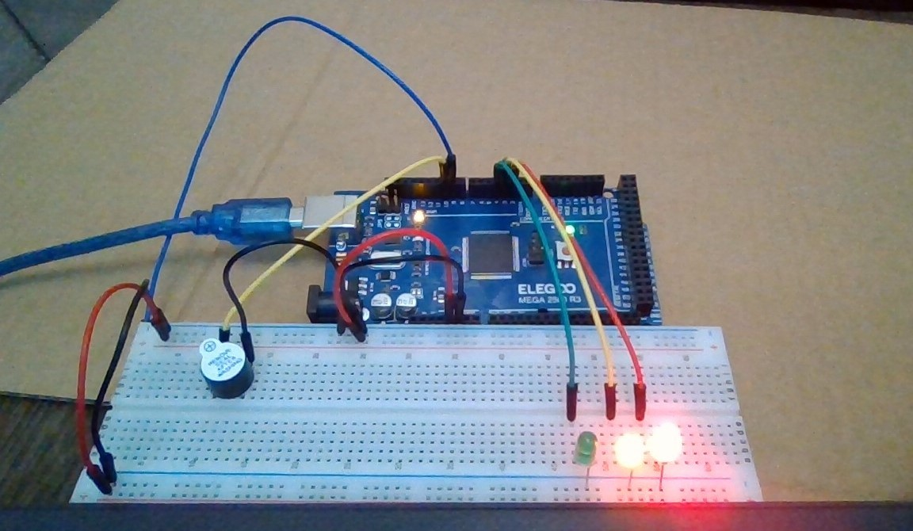
Circuit of door open with Green LED OFF (picture)

Slide 15
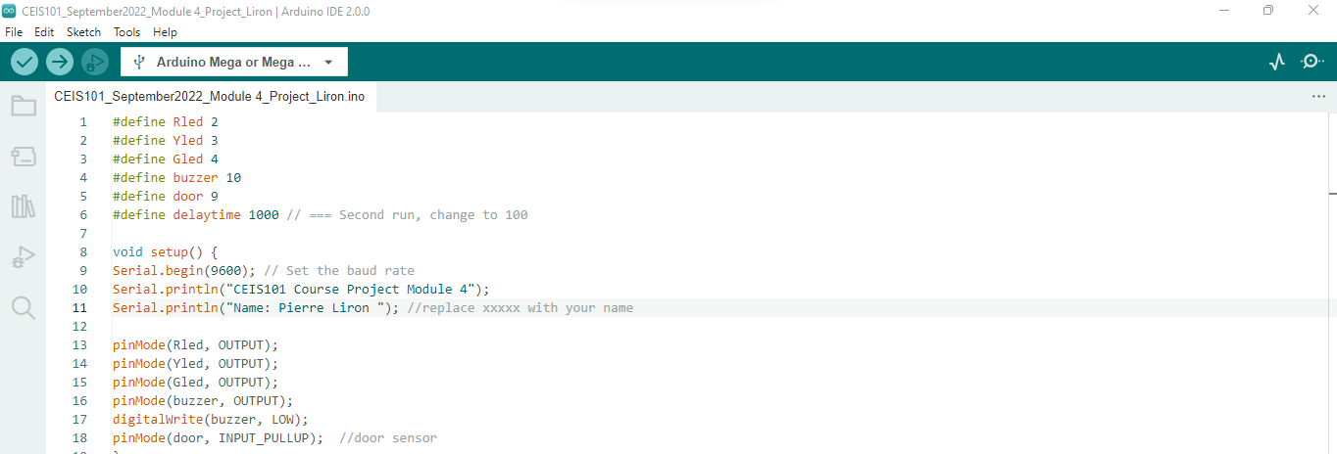
Arduino Code (screenshot)

Slide 16
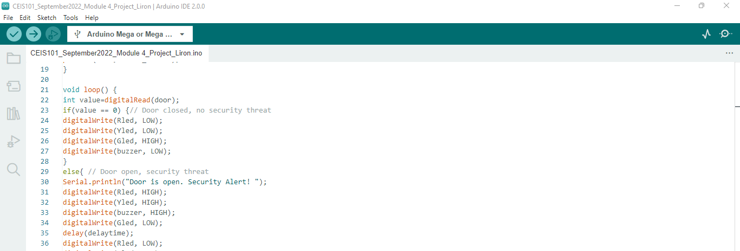
Arduino Code (screenshot)

Slide 17
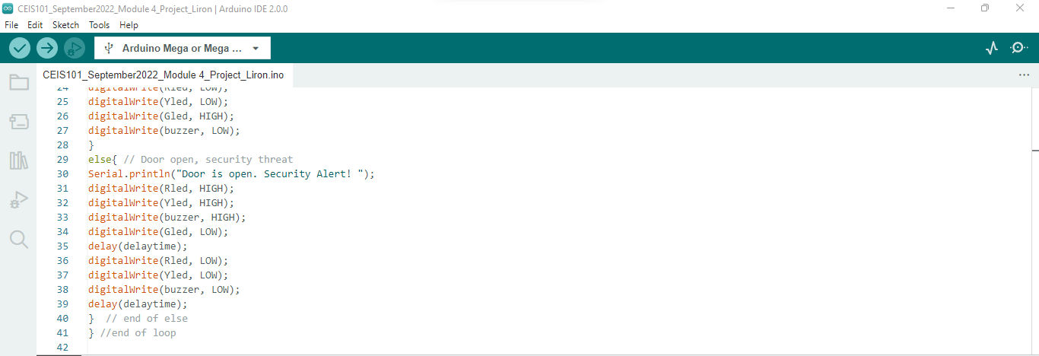
Arduino Code (screenshot)

Slide 18
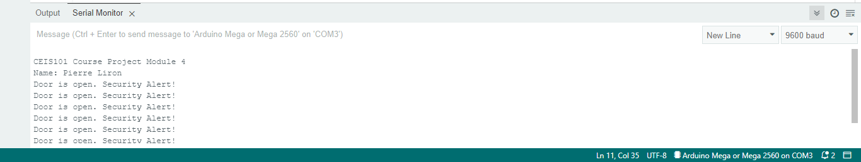
Serial Monitor (screenshot)

Slide 19
ADDING DISTANCE SENSOR TO SMART HOME SYSTEM AND CONDUCTING DATA ANALYSIS

Slide 20
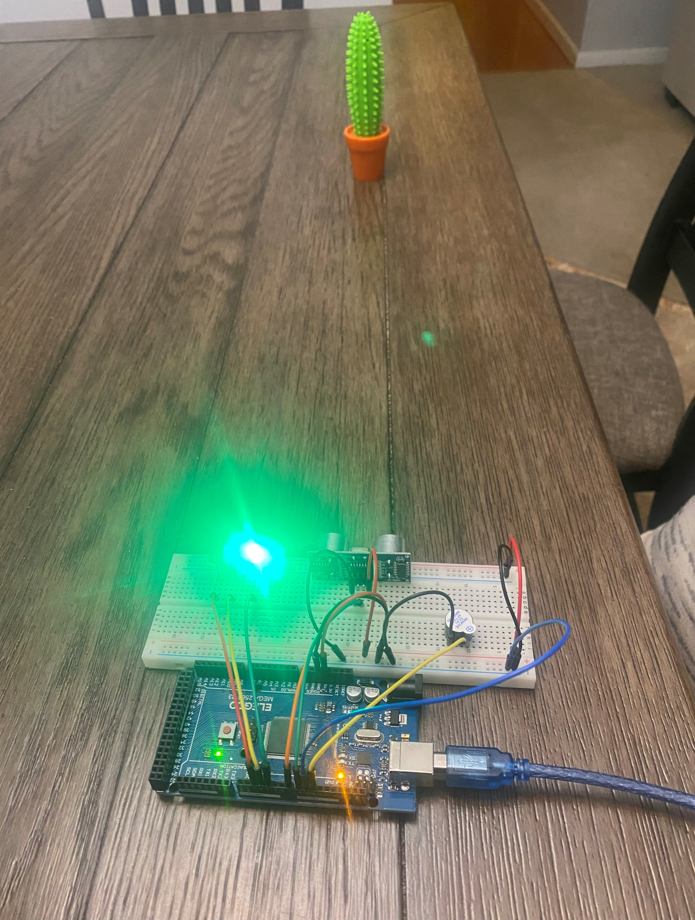
Circuit with green LED on (picture)

Slide 21
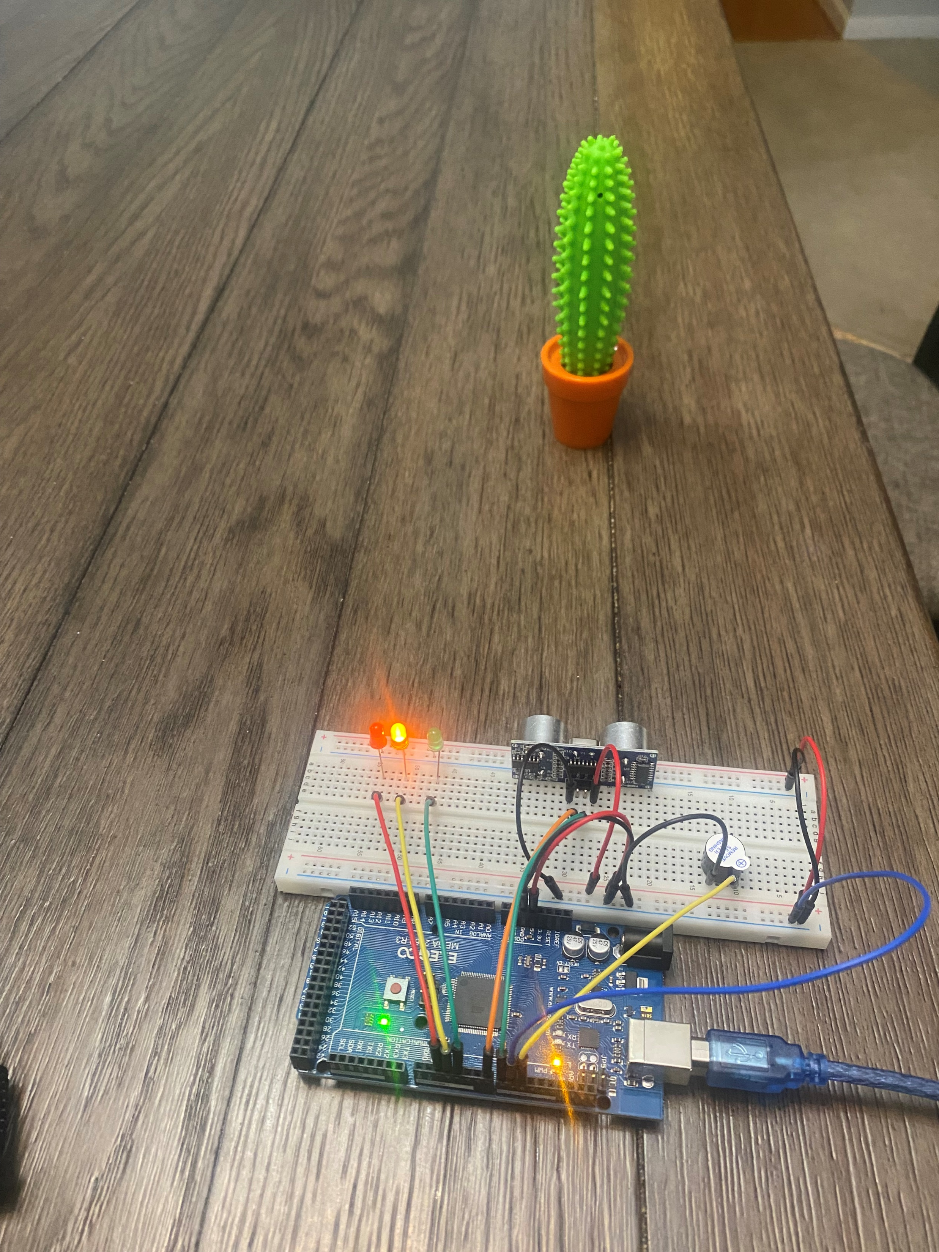
Circuit with yellow LED on (picture)

Slide 22
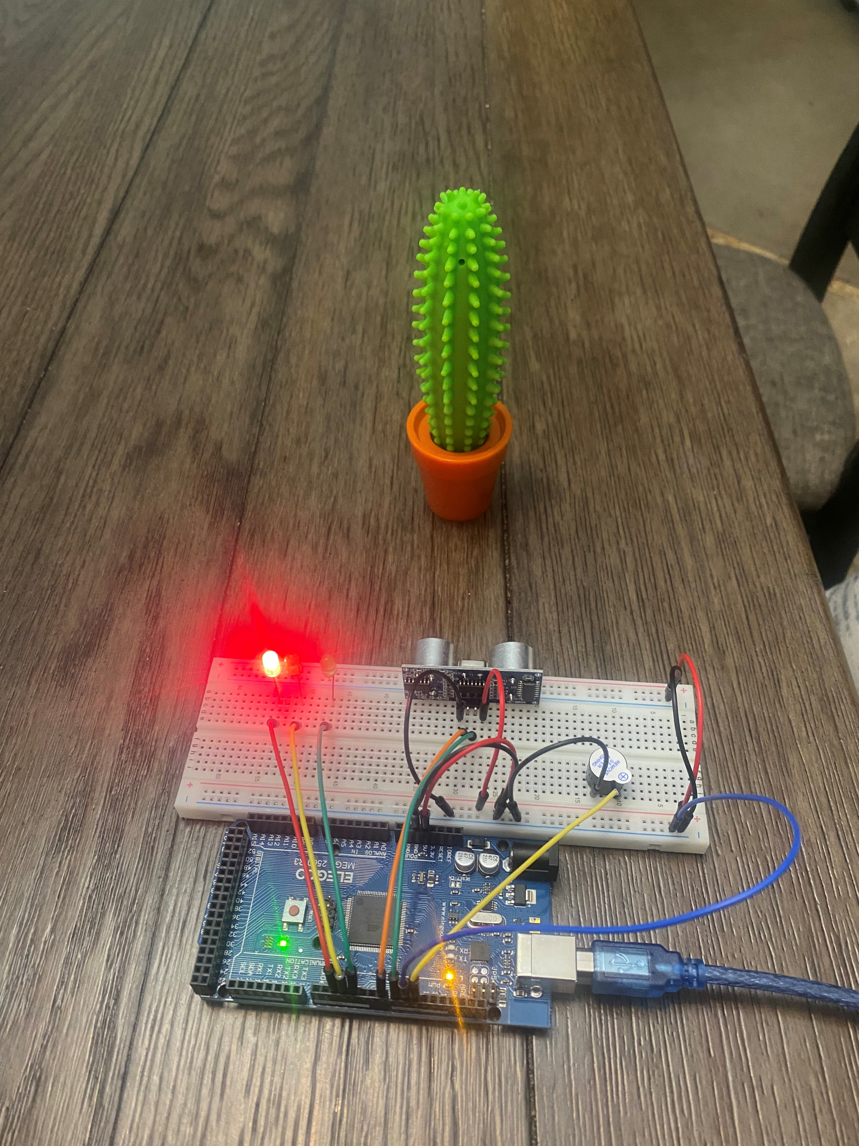
Circuit with red LED on (picture)

Slide 23
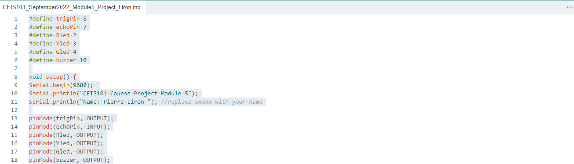
Arduino Code (screenshot)

Slide 24
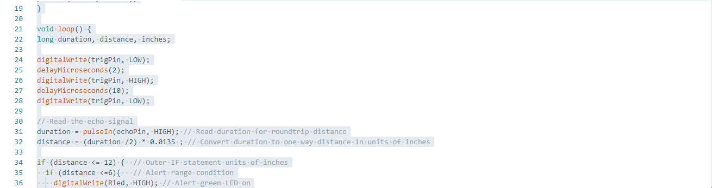
Arduino Code (screenshot)

Slide 25
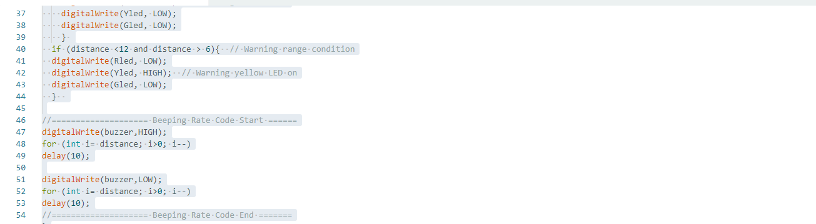
Arduino Code (screenshot)

Slide 26
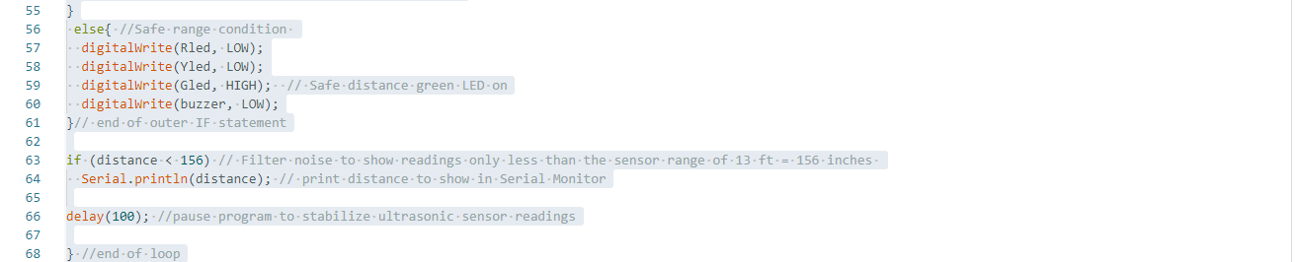
Arduino Code (screenshot)

Slide 27
Plot of data (graph from Excel)

Slide 28

ADDING AUTOMATED LIGHT TO SMART HOME SSYSTEM

Slide 29
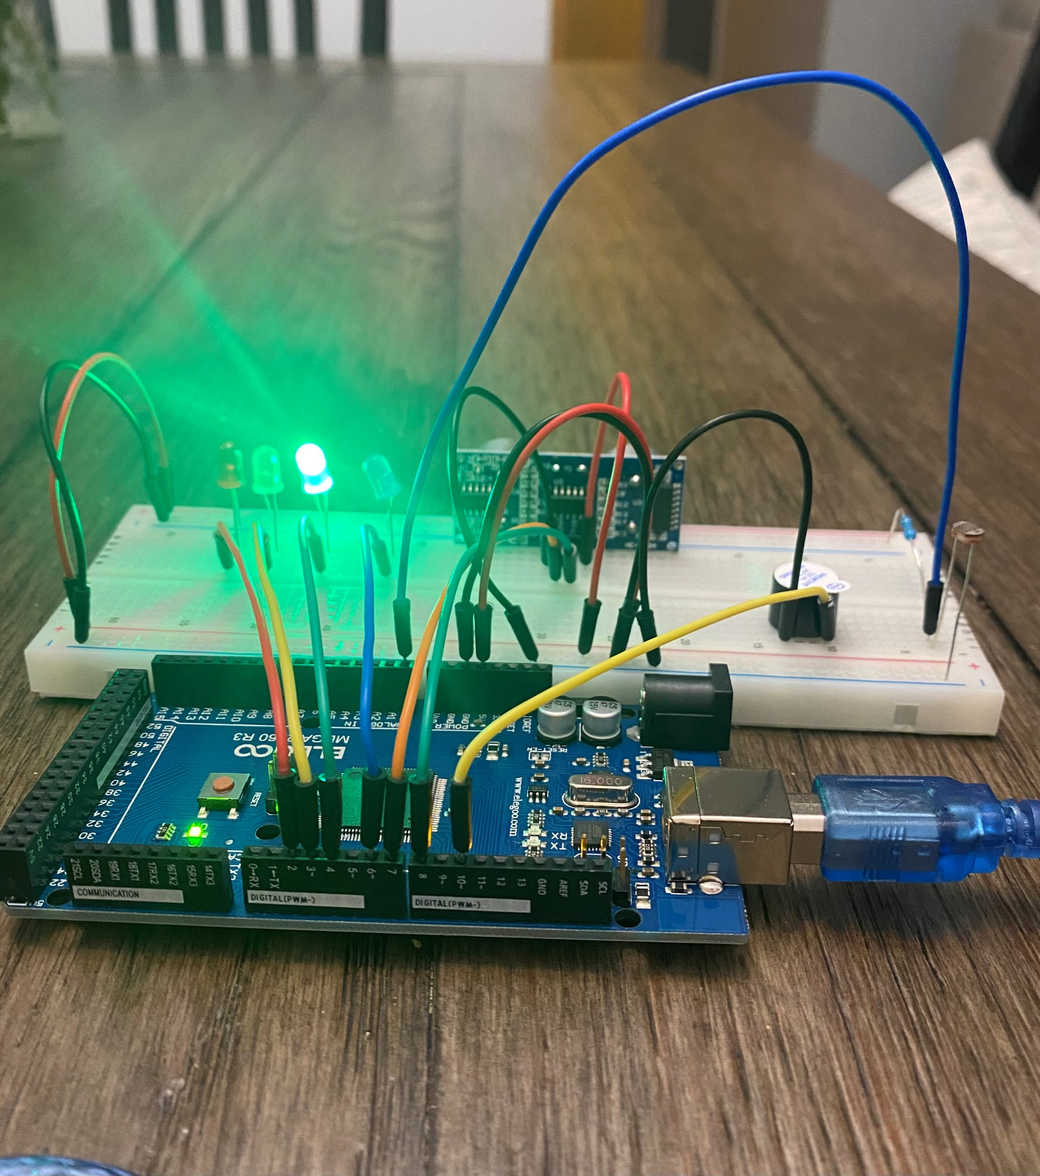
Circuit with automated LED off (picture)

Slide 30
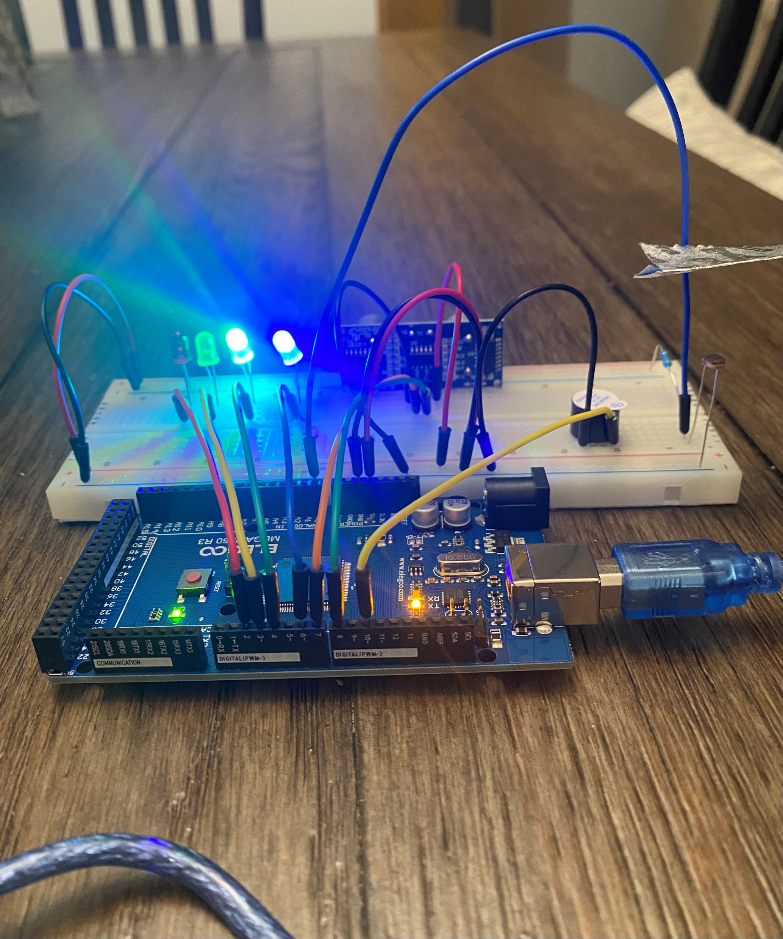
Circuit with automated LED on (picture)

Slide 31
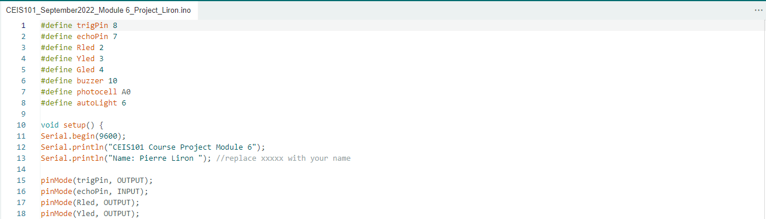
Arduino Code (screenshot)

Slide 32
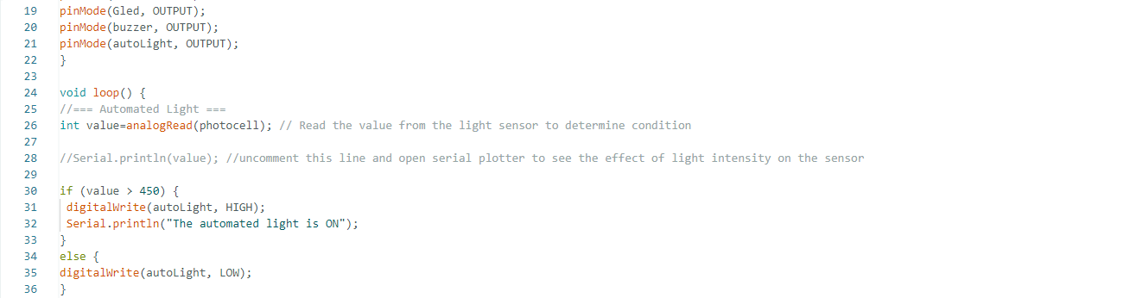
Arduino Code (screenshot)

Slide 33
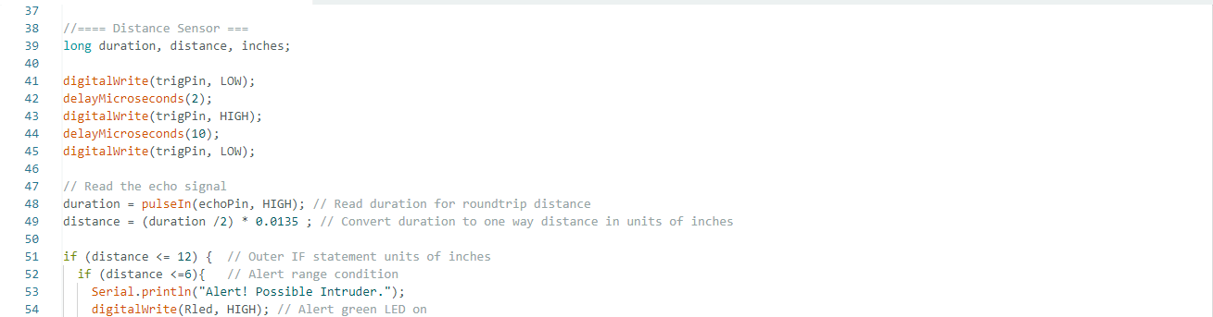
Arduino Code (screenshot)

Slide 34
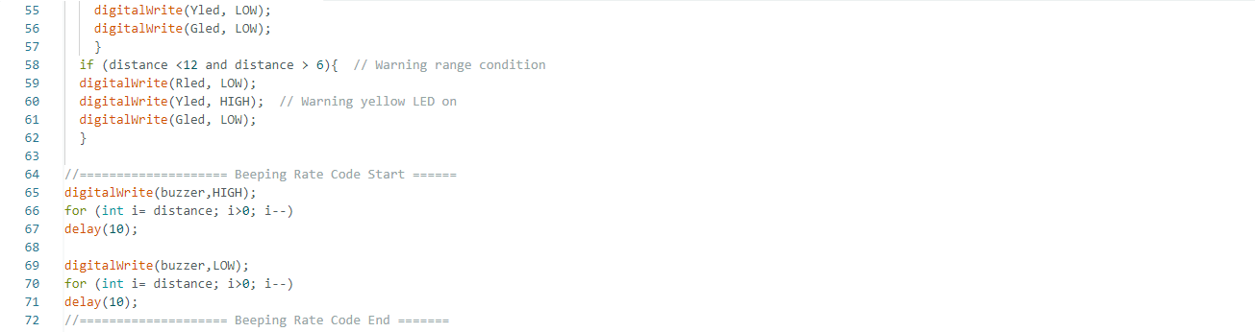
Arduino Code (screenshot)

Slide 35
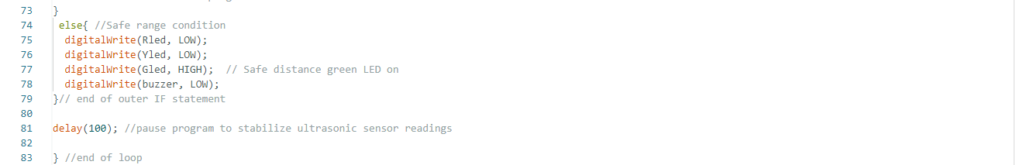
Arduino Code (screenshot)

Slide 36
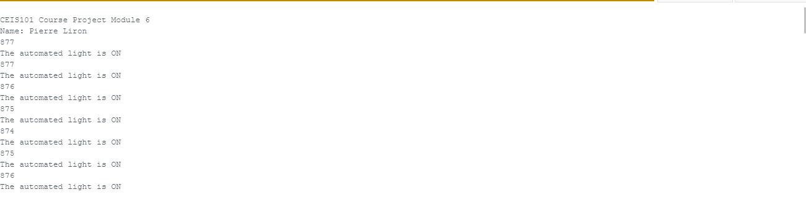
Serial Monitor (screenshot)

Slide 37

CHALLENGES
Some of the challenges that I faced are:
The Arduino 2.0 version that I was using did not work with my Arduino kit I had to downgrade to the Arduino 1.8 version
I had issues compiling the code because the board was not selected
I had to upload the code a few times for it to work
I did not select the COM port or the model of the bord that I was using

Slide 38
CAREER SKILLS ACQUIRED
Sensors and data collection
Prototype building
Coding and programing with Arduino
Working knowledge of IoT and IoE
Security as it relates to software development and IoT

Slide 39
CONCLUSION
This project was a great introduction into IoT and all its capabilities
I impressed to use the same concept I apply to an enterprise network environment as Network Engineer I was able to apply them to IoT
I also have a background working with electronics and mechanical equipment (CT, X-ray, Nuclear cameras, and Locomotives). I was on the other side creating the equipment.

